Slide 1
LSTM
Lecture 6
Part 3
Generative AI for Computer Vision

Slide 2
Content
Problem of RNN
  Vanishing Gradient Problem
  Long-term Contextual Dependency Issue
Introduction to LSTM
LSTM Architecture
How LSTM solves Vanishing Gradient Problem?

Slide 3









































Basic RNN Architecture
$$h_{t}=f_{W}\left(h_{t−1},x_{t}\right)$$
$$h_{t}=tanh(W_{h}h_{t−1}+W_{x}x_{t})$$
$$y_{t}=W_{o}h_{t}$$
O
$$y_{o}$$
$$y_{1}$$
$$y_{2}$$
$$y_{t−1}$$
$$y_{t}$$
$$W_{o}$$
$$W_{o}$$
$$W_{o}$$
$$W_{o}$$
$$W_{o}$$
$$W_{o}$$
Unfold
$$S$$
$$h_{0}$$
$$h_{1}$$
$$h_{t−2}$$
$$h_{t−1}$$
$$h_{t}$$
$$W_{h}$$
$$S_{o}$$
$$S_{1}$$
$$S_{2}$$
$$S_{t−1}$$
$$S_{t}$$
$$W_{h}$$
$$W_{h}$$
$$W_{h}$$
$$W_{h}$$
$$W_{x}$$
$$W_{x}$$
$$W_{x}$$
$$W_{x}$$
$$W_{x}$$
$$W_{x}$$
$$x$$
$$x_{0}$$
$$x_{1}$$
$$x_{2}$$
$$x_{t−1}$$
$$x_{t}$$

Slide 4
Problems of Simple RNN
A major limitation of Recurrent Neural Networks (RNNs) is the vanishing gradient problem that occurs during Backpropagation Through Time (BPTT).
As gradients are propagated backward across multiple time steps, they are repeatedly multiplied by recurrent weights and activation-function derivatives.
When these values are less than one, the gradient magnitude decreases exponentially, causing the gradients associated with earlier time steps to become extremely small or approach zero.
Consequently, the corresponding weight updates become ineffective, making it difficult for the network to learn information from distant time steps.

Slide 5
Problems of Simple RNN
This leads to another significant limitation: difficulty in learning long-term dependencies.
A simple RNN tends to give greater importance to recent inputs while gradually losing information from earlier inputs, thereby limiting its ability to capture relationships across long sequences.
Furthermore, RNNs suffer from sequential computation, since the hidden state at each time step depends on the hidden state from the preceding step.
As a result, the computations cannot be fully parallelized across time steps, leading to slower training and reduced GPU utilization, particularly when processing long sequences.

Slide 6
Vanishing Gradient Problem
Backpropagation through time (BPTT)
With the following equation, we derive the error gradient with respect to $W_{h}$.
Now in, $\frac{∂h_{t}}{∂h_{i}}$, this i and t may be far apart, let say, t=T and i=1 (and T may be a large no. say 50)
$$L=L_{1}+L_{2}+L_{3}+L_{4}$$
$\frac{∂L_{t}}{∂W_{h}}=\frac{∂L_{t}}{∂h_{t}}$ $\sum_{i=1}^{t}{\frac{∂h_{t}}{∂h_{i}}\frac{∂h_{i}}{∂W_{h}}}$
$$O_{1}$$
$$L_{1}$$
$$O_{2}$$
$$L_{2}$$
$$O_{3}$$
$$L_{3}$$
$$O_{4}$$
$$L_{4}$$
$$W_{o}$$
$$W_{o}$$
$$W_{o}$$
$$W_{o}$$
$$h_{1}$$
$$h_{2}$$
$$h_{3}$$
$$h_{4}$$
$$S_{1}$$
$$S_{2}$$
$$S_{3}$$
$$S_{4}$$
$$W_{h}$$
$$W_{h}$$
$$W_{h}$$
$$W_{h}$$
$$W_{x}$$
$$W_{x}$$
$$W_{x}$$
$$W_{x}$$
$$x_{1}$$
$$x_{2}$$
$$x_{3}$$
$$x_{4}$$

Slide 7
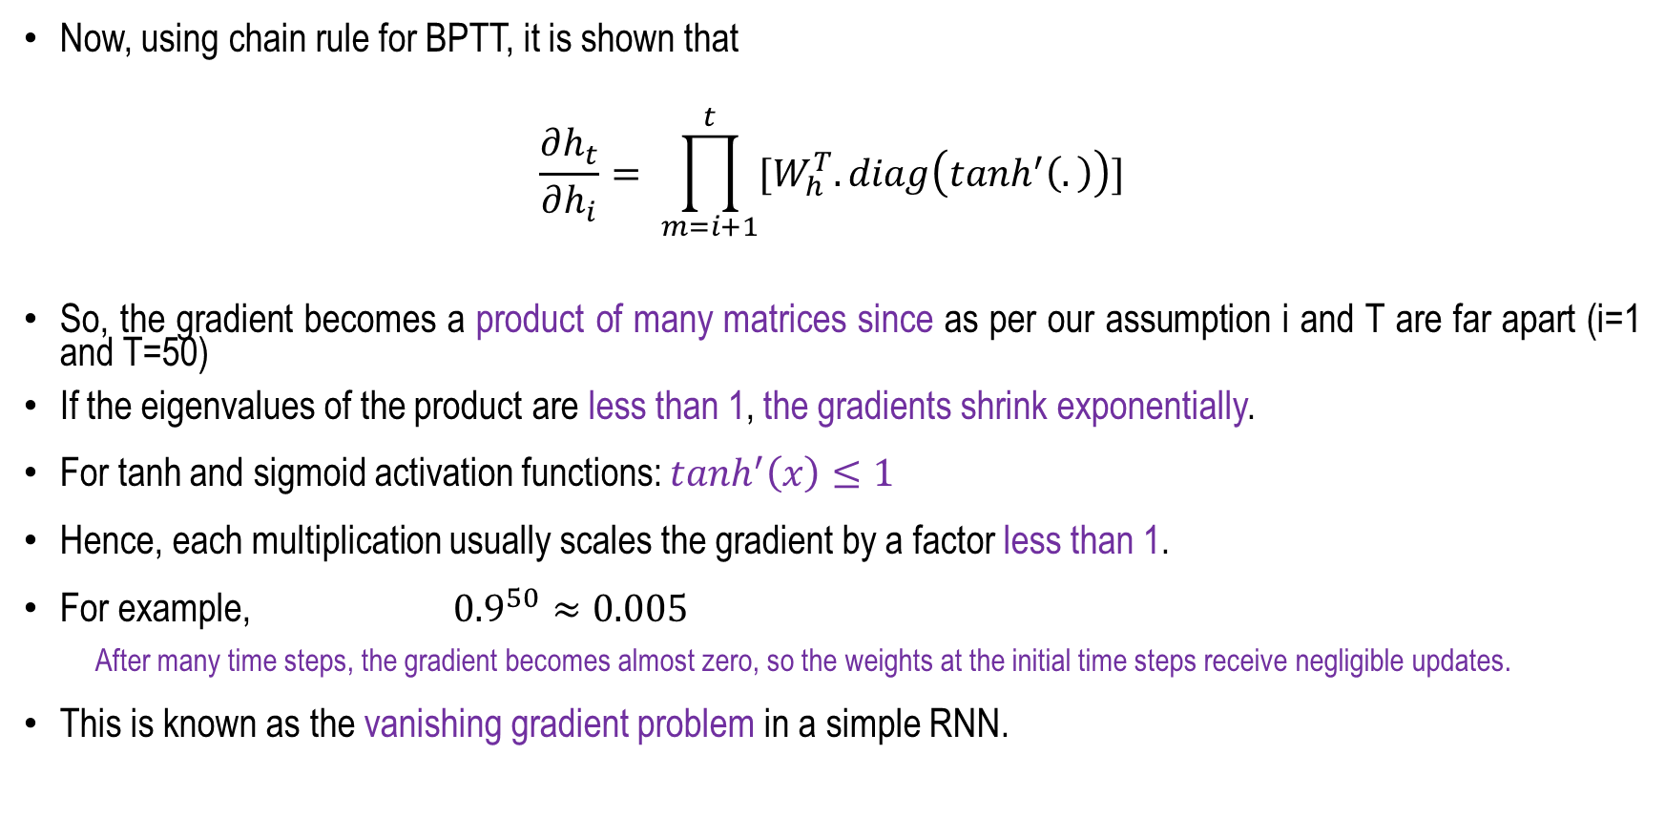
Vanishing Gradient Problem
Now, using chain rule for BPTT, it is shown that
$$\frac{∂h_{t}}{∂h_{i}}= \prod_{m=i+1}^{t}{[W_{h}^{T}.diag\left(tanh^{′}\left(.\right)\right)]}$$
So, the gradient becomes a product of many matrices since as per our assumption i and T are far apart (i=1 and T=50)
If the eigenvalues of the product are less than 1, the gradients shrink exponentially.
For tanh and sigmoid activation functions: $tanh^{′}\left(x\right)≤1$
Hence, each multiplication usually scales the gradient by a factor less than 1.
For example, ${0.9}^{50}≈0.005$
  After many time steps, the gradient becomes almost zero, so the weights at the initial time steps receive negligible updates.
This is known as the vanishing gradient problem in a simple RNN.

Slide 8
The naïve RNN
$$Y_{t}$$
Softmax
$$h_{t}=tanh(W_{h}h_{t−1}+W_{x}x_{t})$$
$$W_{o}$$
$$y_{t}=softmax(W_{o}h_{t})$$
tanh
$$h_{t}$$
$$W_{h}$$
$$h_{t−1}$$
$$W_{x}$$
$$x_{t}$$

Slide 9
RNN: Vanishing Gradient Problem
The kid playing football in the playground, is very happy.
The kids playing football in the playground, are very happy.
During Backpropagation Through Time (BPTT):
  Gradients are multiplied repeatedly across time steps.
  They shrink exponentially (vanishing gradients).
  As a result, earlier time steps receive negligible weight updates and stop learning.
A simple RNN is NOT suitable for learning or representing long-term contextual dependencies in long sequences, such as large sentences.
Outputs
$$o_{1}$$
$$o_{2}$$
$$o_{3}$$
$$o_{k}$$
$$W_{o}$$
$$W_{o}$$
$$W_{o}$$
$$W_{o}$$
$$h_{0}$$
$$S_{1}$$
$$h_{1}$$
$$S_{2}$$
$$h_{2}$$
$$S_{3}$$
$$h_{3}$$
$$h_{k−1}$$
$$S_{k}$$
$$W_{h}$$
$$W_{h}$$
$$W_{h}$$
$$W_{h}$$
$$W_{h}$$
$$W_{x}$$
$$W_{x}$$
$$W_{x}$$
$$x_{1}$$
$$x_{2}$$
$$x_{3}$$
Inputs

Slide 10
Long Short Term Memory (LSTM)
Hochreiter et al., 1997
Long Short-Term Memory (LSTM) is an advanced type of Recurrent Neural Network (RNN) specifically designed to overcome the vanishing gradient problem and improve the learning of long-term dependencies.
Unlike a conventional RNN, an LSTM uses a memory cell and three main gates—
  Forget gate,
  Input gate, and
  Output gate
to regulate the flow of information through the network.
The forget gate determines which information should be discarded, the input gate controls which new information should be stored, and the output gate determines which information should be passed to the next hidden state.

Slide 11
Long Short Term Memory (LSTM)
Hochreiter et al., 1997
Most importantly, the LSTM cell state provides a relatively direct pathway for information and gradients to flow across multiple time steps, reducing the exponential decay of gradients during Backpropagation Through Time (BPTT).
This enables LSTMs to retain relevant information for longer periods and effectively learn long-term dependencies in sequential data.
Therefore, LSTMs provide a more robust solution than simple RNNs for tasks involving long sequences, such as language modeling, speech recognition, machine translation, and time-series prediction.

Slide 12
LSTM Architecture
An LSTM cell consists of a cell state and three primary gates.
  The forget gate determines which information from the previous cell state should be discarded.
  The input gate controls the amount of new information that should be stored in the cell state.
  The output gate determines which portion of the updated cell state is exposed as the hidden state and passed to the next time step.
The cell state acts as a long-term memory pathway, allowing relevant information to flow through multiple time steps with reduced gradient degradation.
Forget Gate
Input Gate
Output Gate
$$C_{t−1}$$
$$C_{t}$$
X
+
X
tanh
$$f_{t}$$
$$i_{t}$$
$$o_{t}$$
$$\tilde{C_{t}}$$
X
$$σ$$
$$σ$$
tanh
$$σ$$
$$h_{t−1}$$
$$h_{t}$$
$$x_{t}$$

Slide 13
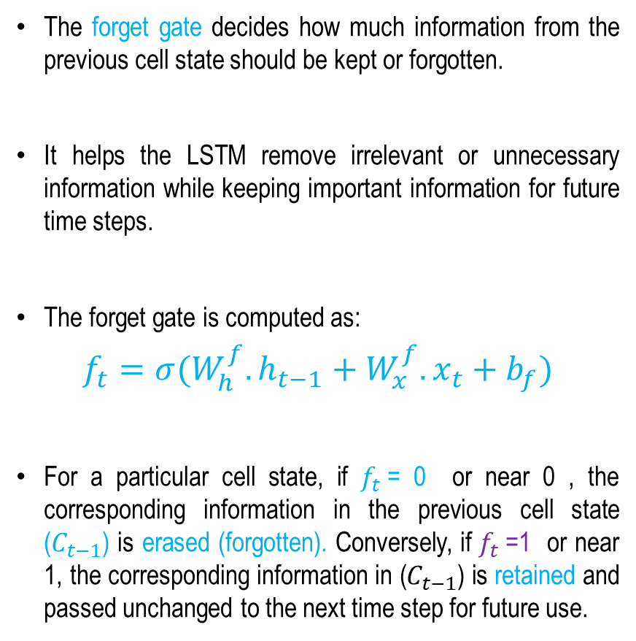
Forget Gate (Controls Memory)
The forget gate decides how much information from the previous cell state should be kept or forgotten.
It helps the LSTM remove irrelevant or unnecessary information while keeping important information for future time steps.
The forget gate is computed as:
$$f_{t}=σ(W_{h}^{f}.h_{t−1}+W_{x}^{f}.x_{t}+b_{f})$$
For a particular cell state, if $f_{t}$= 0 or near 0 , the corresponding information in the previous cell state ($C_{t−1}$) is erased (forgotten). Conversely, if $f_{t}$=1 or near 1, the corresponding information in ($C_{t−1}$) is retained and passed unchanged to the next time step for future use.
Forget Gate
$$C_{t−1}$$
$$C_{t}$$
X
+
X
tanh
$$f_{t}$$
$$i_{t}$$
$$o_{t}$$
$$\tilde{C_{t}}$$
X
$$σ$$
$$σ$$
tanh
$$σ$$
$$h_{t−1}$$
$$h_{t}$$
$$x_{t}$$
Concept taken from: https://colah.github.io/posts/2015-08-Understanding-LSTMs/

Slide 14
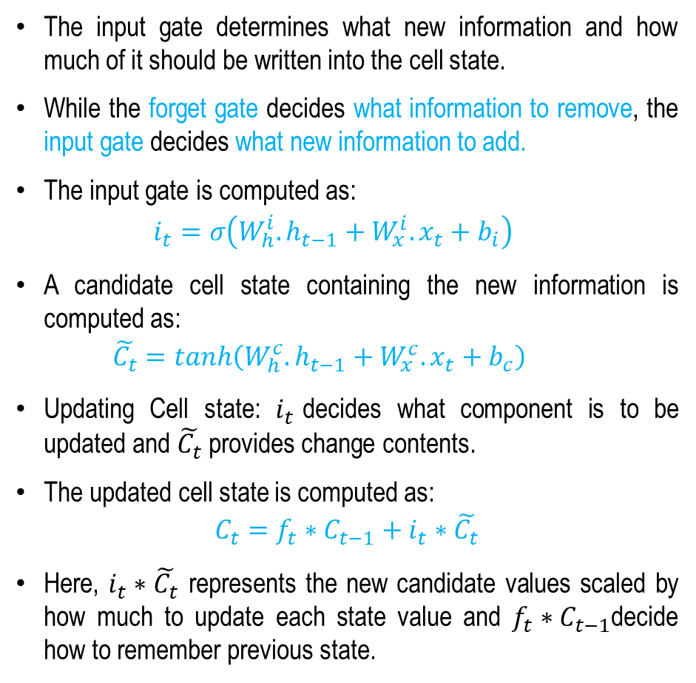
Input Gate (Selective Writing)
The input gate determines what new information and how much of it should be written into the cell state.
While the forget gate decides what information to remove, the input gate decides what new information to add.
The input gate is computed as:
  $$i_{t}=σ\left(W_{h}^{i}.h_{t−1}+W_{x}^{i}.x_{t}+b_{i}\right)$$
A candidate cell state containing the new information is computed as:
  $$\tilde{C_{t}}=\tanh\left(W_{h}^{c}.h_{t−1}+W_{x}^{c}.x_{t}+b_{c}\right)$$
Updating Cell state: $i_{t}$decides what component is to be updated and $\tilde{C_{t}}$ provides change contents.
The updated cell state is computed as:
$$C_{t}=f_{t}∗C_{t−1}+i_{t}∗\tilde{C_{t}}$$
Here, $i_{t}∗\tilde{C_{t}}$ represents the new candidate values scaled by how much to update each state value and $f_{t}∗C_{t−1}$decide how to remember previous state.
Input Gate
$$C_{t−1}$$
$$C_{t}$$
X
+
X
tanh
$$f_{t}$$
$$i_{t}$$
$$o_{t}$$
$$\tilde{C_{t}}$$
X
$$σ$$
$$σ$$
tanh
$$σ$$
$$h_{t−1}$$
$$h_{t}$$
$$x_{t}$$
Concept taken from: https://colah.github.io/posts/2015-08-Understanding-LSTMs/

Slide 15
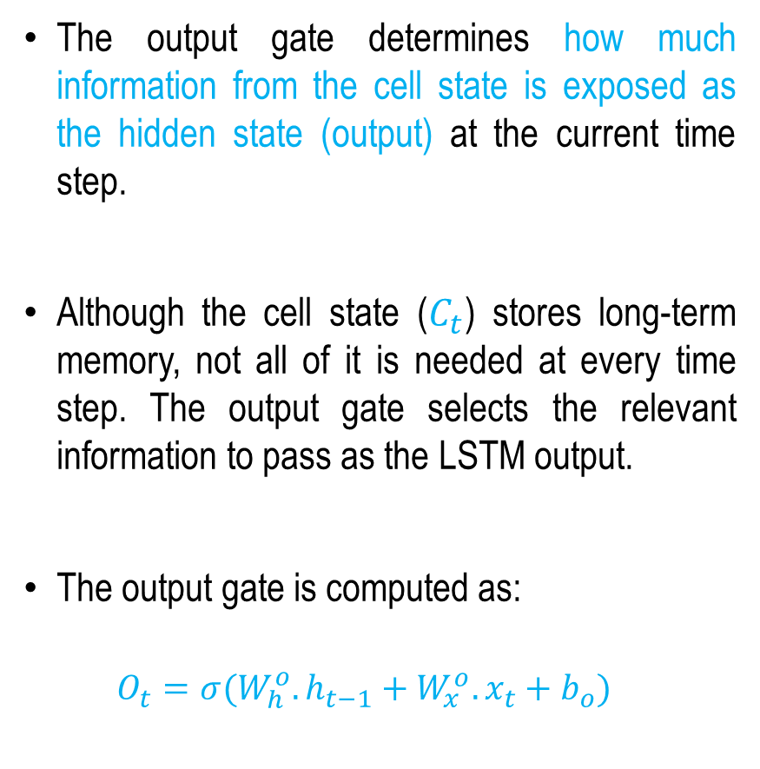
Output Gate (Controlled Exposure)
The output gate determines how much information from the cell state is exposed as the hidden state (output) at the current time step.
Although the cell state ($C_{t}$) stores long-term memory, not all of it is needed at every time step. The output gate selects the relevant information to pass as the LSTM output.
The output gate is computed as:
  $$O_{t}=σ(W_{h}^{o}.h_{t−1}+W_{x}^{o}.x_{t}+b_{o})$$
Output Gate
$$C_{t−1}$$
$$C_{t}$$
X
+
X
tanh
$$f_{t}$$
$$i_{t}$$
$$o_{t}$$
$$\tilde{C_{t}}$$
X
$$σ$$
$$σ$$
tanh
$$σ$$
$$h_{t−1}$$
$$h_{t}$$
$$x_{t}$$
Concept taken from: https://colah.github.io/posts/2015-08-Understanding-LSTMs/

Slide 16
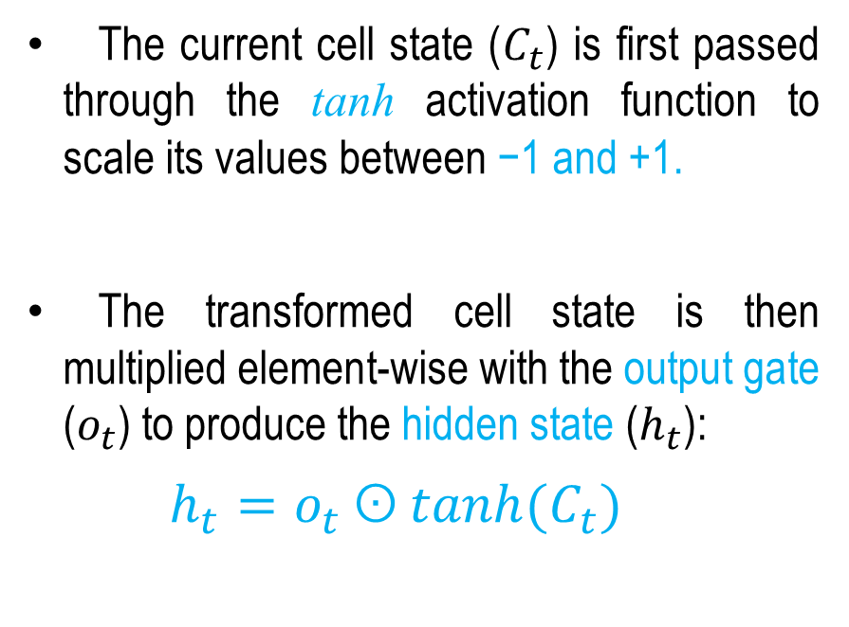
Output Gate (Controlled Exposure)
The current cell state ($C_{t}$) is first passed through the tanh activation function to scale its values between −1 and +1.
The transformed cell state is then multiplied element-wise with the output gate ($o_{t}$​) to produce the hidden state ($h_{t}$):
$h_{t}=o_{t} ʘ tanh⁡(C_{t})$
Output Gate
$$C_{t−1}$$
$$C_{t}$$
X
+
X
tanh
$$f_{t}$$
$$i_{t}$$
$$o_{t}$$
$$\tilde{C_{t}}$$
X
$$σ$$
$$σ$$
tanh
$$σ$$
$$h_{t−1}$$
$$h_{t}$$
$$x_{t}$$
Concept taken from: https://colah.github.io/posts/2015-08-Understanding-LSTMs/

Slide 17
Cell State
LSTM introduces a memory cell (cell state) and gates that regulate the flow of information.
$$C_{t−2}$$
$$C_{t−1}$$
$$C_{t}$$
$$C_{t+1}$$
X
+
X
+
X
+
X
tanh
X
tanh
X
tanh
$$f_{t}$$
$$i_{t}$$
$$\tilde{C_{t}}$$
$$o_{t}$$
$$σ$$
tanh
X
$$σ$$
tanh
X
$$σ$$
$$σ$$
tanh
X
$$σ$$
$$σ$$
$$σ$$
$$σ$$
$$σ$$
$$h_{t−1}$$
$$h_{t}$$
$$x_{t}$$
$$C_{t}=f_{t}∗C_{t−1}+i_{t}∗\tilde{C_{t}}$$
The core idea of an LSTM is the cell state ($C_{t}$​), which changes gradually through simple linear updates, allowing information to flow over long time steps with minimal change.
Concept taken from CS231n: Stanford Lecture by Fei Fei Li et. al.

Slide 18
How LSTM solves the vanishing gradient problem?
Instead of repeatedly multiplying hidden states, an LSTM updates its cell state using additive operations:
New information is added to the cell state rather than repeatedly multiplied.
Since information is added rather than repeatedly multiplied, gradients can flow backward with minimal decay.
This mechanism is called the Constant Error Carousel (CEC).
As a result, gradients can propagate across many time steps without vanishing. Thus solve the vanishing gradient problem.
$$C_{t}=f_{t}∗C_{t−1}+i_{t}∗\tilde{C_{t}}$$
$$C_{t−1}$$
$$C_{t}$$
X
+
X
tanh
$$f_{t}$$
$$i_{t}$$
$$\tilde{C_{t}}$$
X
$$σ$$
$$σ$$
tanh
$$σ$$
$$h_{t−1}$$
$$h_{t}$$
$$x_{t}$$
Concept taken from CS231n: Stanford Lecture by Fei Fei Li et. al.

Slide 19
How LSTM Solves Long-term Dependency Issue?
Long-Term Dependency Issue :
  "The movie, which I watched last Saturday and absolutely loved, was fantastic."
  Here, the verb "was" depends on “movie", not "loved". A simple RNN may forget “movie", while an LSTM can remember it through its memory cell.
How LSTM Fixes This:
  LSTM introduces a memory cell (cell state) and gates that regulate the flow of information.
  The cell state acts as a memory highway, allowing information and gradients to flow almost unchanged across many time steps.
  This enables LSTMs to learn long-term dependencies and greatly reduce the vanishing gradient problem.
$$C_{t−1}$$
$$C_{t}$$
X
+
X
tanh
$$f_{t}$$
$$i_{t}$$
$$\tilde{C_{t}}$$
X
$$σ$$
$$σ$$
tanh
$$σ$$
$$h_{t−1}$$
$$h_{t}$$
$$x_{t}$$

Slide 20
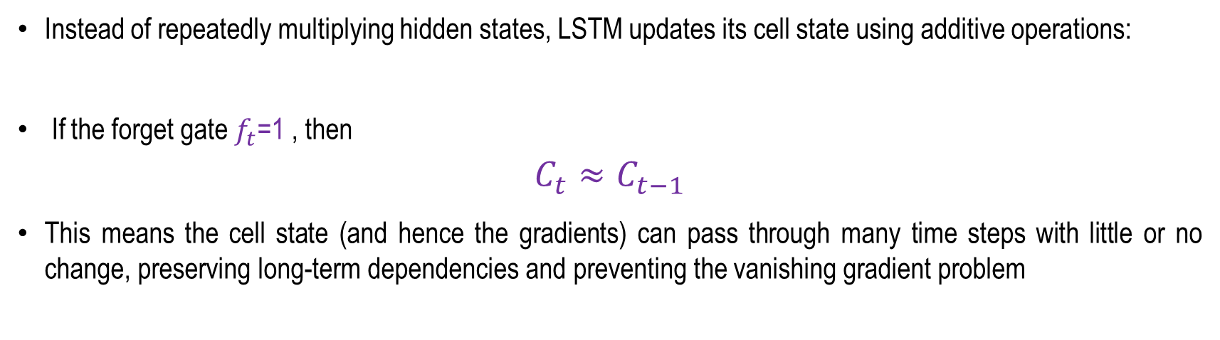


How LSTM Solves Long-term Dependency Issue?
Instead of repeatedly multiplying hidden states, LSTM updates its cell state using additive operations:
​ If the forget gate $f_{t}$=1 , then
$$C_{t}≈C_{t−1}$$
This means the cell state (and hence the gradients) can pass through many time steps with little or no change, preserving long-term dependencies and preventing the vanishing gradient problem
$$C_{t}=f_{t}∗C_{t−1}+i_{t}∗\tilde{C_{t}}$$
The movie, which I watched last Saturday and absolutely loved, was fantastic
$$C_{t−1}$$
$$C_{t}$$
X
+
X
tanh
$f_{t}=$1
$$f_{t}$$
$$i_{t}$$
$$\tilde{C_{t}}$$
X
$$σ$$
$$σ$$
tanh
$$σ$$
When $f_{t}$=1, $C_{t}≈C_{t−1}$, so maintaining the previous state value.
$$h_{t−1}$$
$$h_{t}$$
$$x_{t}$$

Slide 21
Summery
Problem of RNN
  Vanishing Gradient Problem
  Long-term Contextual Dependency Issue
Introduction to LSTM
LSTM Architecture
How LSTM solves Vanishing Gradient Problem?

Slide 22
Sequence Modeling - II
Next
Lecture 6: Part 4
Generative AI for Computer Vision

Slide 23
Vanishing Gradient Problem
Now, we expand $\frac{∂h_{t}}{∂h_{i}}$
$$\frac{∂h_{t}}{∂h_{i}}=\frac{∂h_{t}}{∂h_{t−1}}\frac{∂h_{t−1}}{∂h_{t−2}}\frac{∂h_{t−2}}{∂h_{t−3}}⋯\frac{∂h_{i+1}}{∂h_{i}}$$
$$= \prod_{m=i+1}^{t}{\frac{∂h_{m}}{∂h_{m−1}}}$$
$$L=L_{1}+L_{2}+L_{3}+L_{4}$$
$$O_{1}$$
$$L_{1}$$
$$O_{2}$$
$$L_{2}$$
$$O_{3}$$
$$L_{3}$$
$$O_{4}$$
$$L_{4}$$
$$W_{o}$$
$$W_{o}$$
$$W_{o}$$
$$W_{o}$$
$$h_{1}$$
$$h_{2}$$
$$h_{3}$$
$$h_{4}$$
$$S_{1}$$
$$S_{2}$$
$$S_{3}$$
$$S_{4}$$
$$W_{h}$$
$$W_{h}$$
$$W_{h}$$
$$W_{h}$$
$$W_{x}$$
$$W_{x}$$
$$W_{x}$$
$$W_{x}$$
$$x_{1}$$
$$x_{2}$$
$$x_{3}$$
$$x_{4}$$
Concept taken from Deep Learning Lecture Prof. M Khapra, IIT Madras

Slide 24
Vanishing Gradient Problem
$$\frac{∂h_{m}}{∂a_{m}}=\left[\begin{matrix}\frac{∂h_{m1}}{∂a_{m1}} & \frac{∂h_{m2}}{∂a_{m1}} & \begin{matrix}\frac{∂h_{m3}}{∂a_{m1}} & …\end{matrix} \\ \frac{∂h_{m1}}{∂a_{m2}} & \frac{∂h_{m2}}{∂a_{m2}} & \begin{matrix}⋱ & …\end{matrix} \\ ⋮ & ⋮ & \begin{matrix}⋮ & \frac{∂h_{mT}}{∂a_{mT}}\end{matrix}\end{matrix}\right]$$
In this matrix, the off-diagonal elements are zero.
The diagonal matrix is
$$=\left[\begin{matrix}\frac{∂h_{m1}}{∂a_{m1}} & 0 & \begin{matrix}0 & …\end{matrix} \\ 0 & \frac{∂h_{m2}}{∂a_{m2}} & \begin{matrix}⋱ & …\end{matrix} \\ ⋮ & ⋮ & \begin{matrix}⋮ & \frac{∂h_{mT}}{∂a_{mT}}\end{matrix}\end{matrix}\right]$$
= $\left[\begin{matrix}tanh′(a_{m1}) & 0 & \begin{matrix}0 & …\end{matrix} \\ 0 & tanh′(a_{m2}) & \begin{matrix}⋱ & …\end{matrix} \\ ⋮ & ⋮ & \begin{matrix}⋮ & tanh′(a_{mT})\end{matrix}\end{matrix}\right]$
$$=diag(tanh^{′}\left(a_{m}\right))$$
Now, for $\frac{∂h_{m}}{∂h_{m−1}}$
$$a_{m}=W_{h}h_{m−1}+b+ W_{x}x_{m}$$
$$h_{m}=tanh⁡(a_{m})$$
$$\frac{∂h_{m}}{∂h_{m−1}}=\frac{∂h_{m}}{∂a_{m}}\frac{∂a_{m}}{∂h_{m−1}}$$
As in our case, the no. of RNN nodes involved is T.
Concept taken from Deep Learning Lecture Prof. M Khapra, IIT Madras

Slide 25
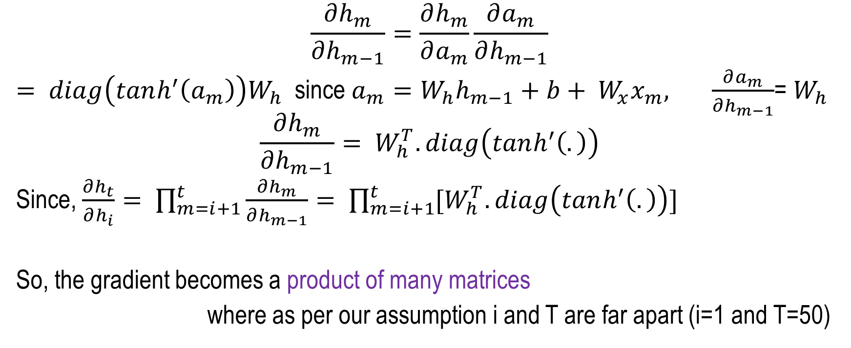
Vanishing Gradient Problem
$$\frac{∂h_{m}}{∂h_{m−1}}=\frac{∂h_{m}}{∂a_{m}}\frac{∂a_{m}}{∂h_{m−1}}$$
$= diag\left(tanh^{′}\left(a_{m}\right)\right)W_{h}$ since $a_{m}=W_{h}h_{m−1}+b+ W_{x}x_{m}, \frac{∂a_{m}}{∂h_{m−1}}$= $W_{h}$
$$\frac{∂h_{m}}{∂h_{m−1}}= W_{h}^{T}.diag\left(tanh^{′}\left(.\right)\right)$$
Since, $\frac{∂h_{t}}{∂h_{i}}= \prod_{m=i+1}^{t}{\frac{∂h_{m}}{∂h_{m−1}}}= \prod_{m=i+1}^{t}{[W_{h}^{T}.diag\left(tanh^{′}\left(.\right)\right)]}$
So, the gradient becomes a product of many matrices
where as per our assumption i and T are far apart (i=1 and T=50)
Constant
Concept taken from Deep Learning Lecture Prof. M Khapra, IIT Madras

Slide 26
Vanishing Gradient Problem
During Backpropagation Through Time (BPTT), the gradient becomes the product of many matrices:
where i and T are far apart (e.g., i=1 and T=50)
If the eigenvalues of the product are less than 1, the gradients shrink exponentially.
If the eigenvalues are greater than 1, the gradients grow exponentially, leading to the exploding gradient problem.
For tanh and sigmoid activation functions: $tanh^{′}\left(x\right)≤1$
Hence, each multiplication usually scales the gradient by a factor less than 1.
For example, ${0.9}^{50}≈0.005$
  After many time steps, the gradient becomes almost zero, so the weights at the initial time steps receive negligible updates.
This is known as the vanishing gradient problem in a simple RNN.
$\prod_{m=i+1}^{t}{[W_{h}^{T}.diag\left(tanh^{′}\left(.\right)\right)]}$​

